Slide 1
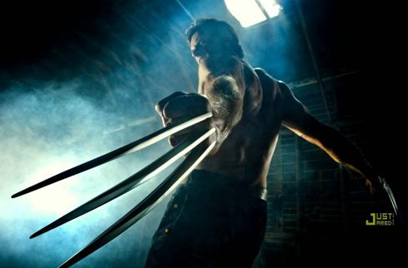
Film Elements
Understanding Film

Slide 2
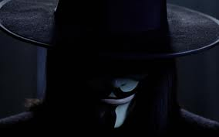
Colour
Colour: How is colour applied to the overall “look” of the film, to character, to costuming and to props?
Is there a symbolic and/or atmospheric purpose?
What colour contrasts are present from one scene to another, and what is the purpose?
What is the mood and tone of the film as the result of the colour?
Note: you must consider colour in terms of the evolution of film. Was the film created in a time of black and white cinematography?
Alberta Education

Slide 3
Music
How does the music define the atmosphere, mood and tone of a scene?
Does music define or identify characters?
Does music assist the transition of time?
Is the music a marketing tool?
Alberta Education

Slide 4
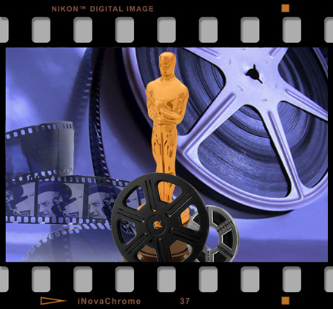
The Shots
Frame: Individual photographic image making up the film. Also refers to the area of the picture seen on the screen. . It can also refer to a single photograph from the filmstrip.
The “shots” are defined by the amount of subject matter that’s included within the frame of the screen. (Louis Giannetti)

Slide 5
Shots-Camera Distance
shot In terms of camera distance with respect to the object within the shot, there are basically 6 types of shots;
extreme long shot or distance shot
long shot
extreme close-up
close-up
full shot
medium shot
Australian National University

Slide 6
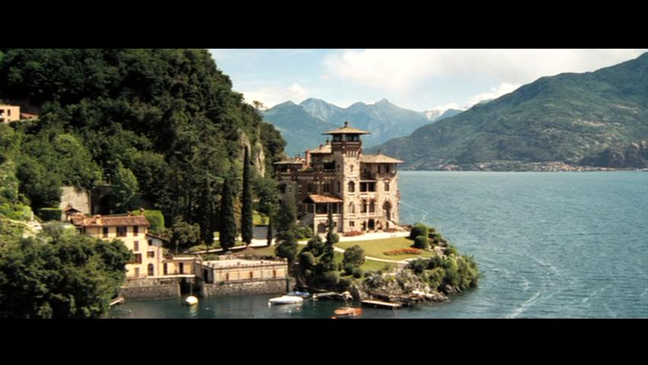
Extreme Long Shot
Taken from a great distance
Almost always an exterior shot
Serve as spatial frames of reference for the closer shots and for this reason are sometimes called – establishing shots
Mostly found in Epic films , where the location plays an important role

Slide 7
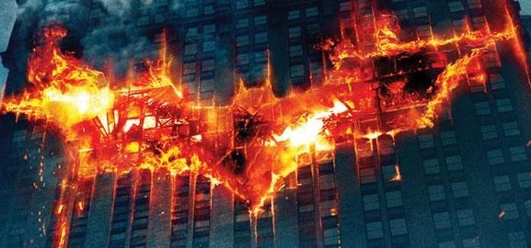
Long Shot
Most complex in the cinema
Correspond approximately to the distance between the audience and the stage in the live theatre

Slide 8
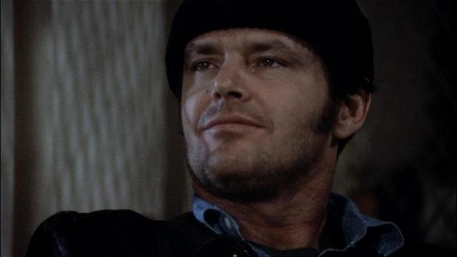
The Close Up
Shows very little, if any locale
Concentrates on a relatively small object – the human face
Tends to elevate the importance of things or symbols

Slide 9
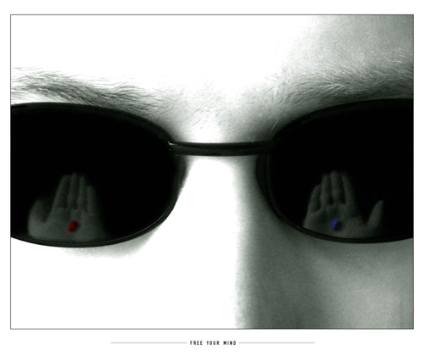
Extreme Close Up
A variation of the close up shot
Instead of the face, it may show only a person’s eye or mouth
Connotation can be of intimacy, of having access to the mind or thought processes (including the subconscious) of the character.
These shots can be used to stress the importance of a particular character at a particular moment in a film..
They can designate imminent action (a hand picking up a knife, for example), and thereby create suspense.
They are very symbolic.
Or they can signify that an object will have an important role to play in the development of the narrative..

Slide 10
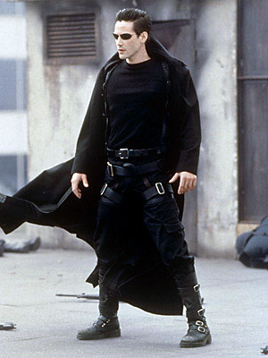
The Full Shot
Just barely includes the human body in full view.
The person becomes the main/only point of focus.

Slide 11
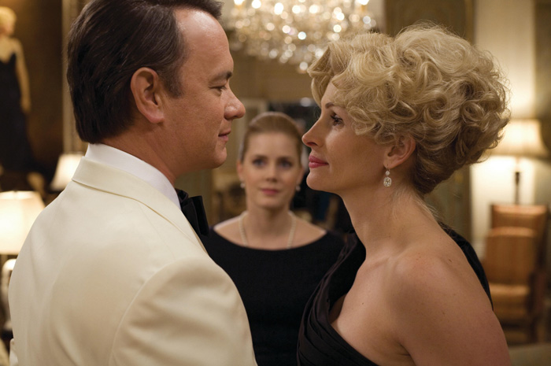
Medium Shot
Contains a figure from the knees or waist up
The “Over the Shoulder” shot usually contains two figures, one with part of his or her back to the camera, the other facing the camera
Functional for scenes of dialogue

Slide 12
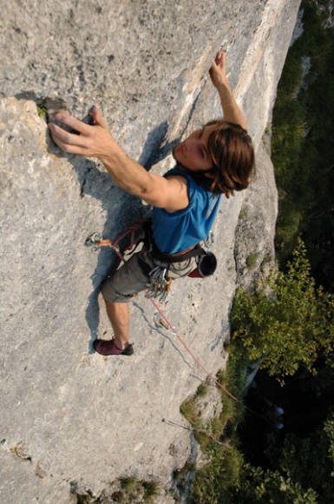
Camera Angles
The angle from which an object is photographed can often serve as a commentary on the subject matter. If the angle is slight, it can serve as a subtle form of emotional coloration. If the angle is extreme, it can represent the major meaning of the object.
The angle is determined by where the camera is placed, not the subject being photographed.

Slide 13
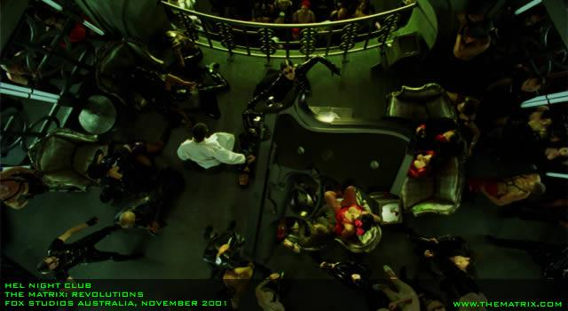
Bird’s Eye View
A scene from directly overhead, or unnatural and strange angles.
This shot puts the viewer in a ‘god-like’ position, looking down on the scene.
Actors are made to look smaller, ant-like, and part of the larger scheme.

Slide 14
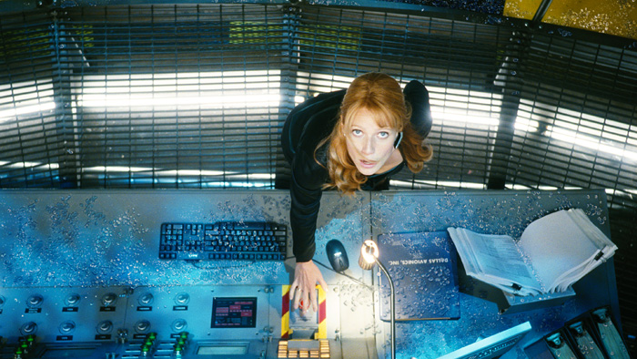
High Angle
Less extreme then the birds eye view
Actors appear smaller and less powerful.

Slide 15
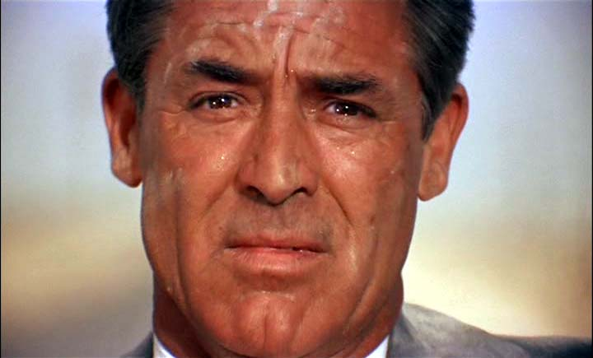
Eye Level Shot
Shot at eye-level, the impression is neutral.

Slide 16
Low Angle
Increase a characters height
Heighten the importance of the subject
The camera looks up at a subject

Slide 17
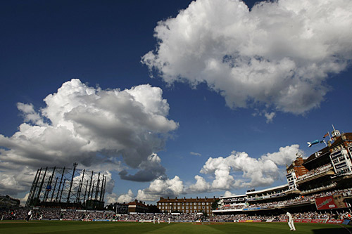
Wide Angle
Offers a greater panorama without the camera having to pan or move.

Slide 18
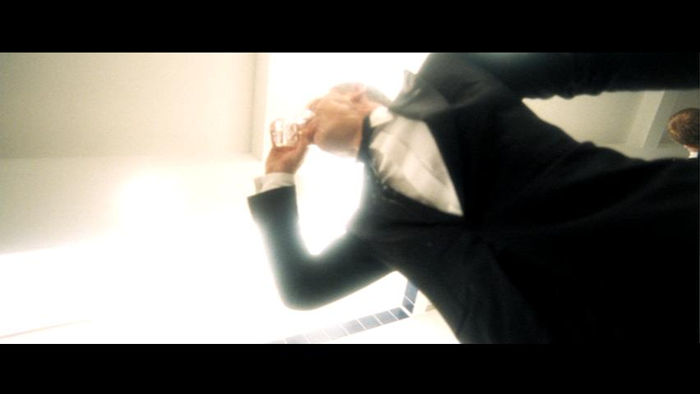
Canted/Oblique Angle
A lateral tilt of the camera
Suggests imbalance and instability.

Slide 19
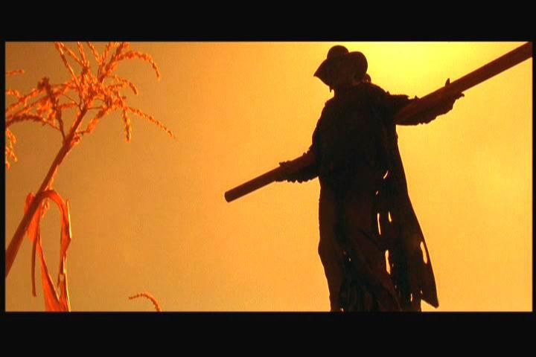
Lighting
There are a number of different styles of lighting. Usually designated a lighting Key, the style is geared towards the theme and mood of the film, as well as its genre.

Slide 20
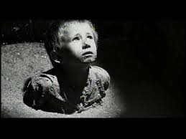
Lighting
Are the scenes brightly lit? Is there much shadow and darkness? What is the purpose of such lighting? Does the lighting focus on a character or object? Why?
Is the lighting realistic, symbolic, designed to draw the audience’s attention to detail?
Are shadows used to conceal, to dramatize or to symbolize aspects of character, action and theme?
Alberta Education

Slide 21
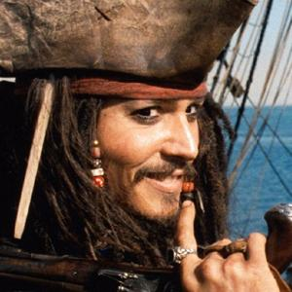
Key Lighting
The main light on a subject.
There are two types of key lighting: High and Low

Slide 22
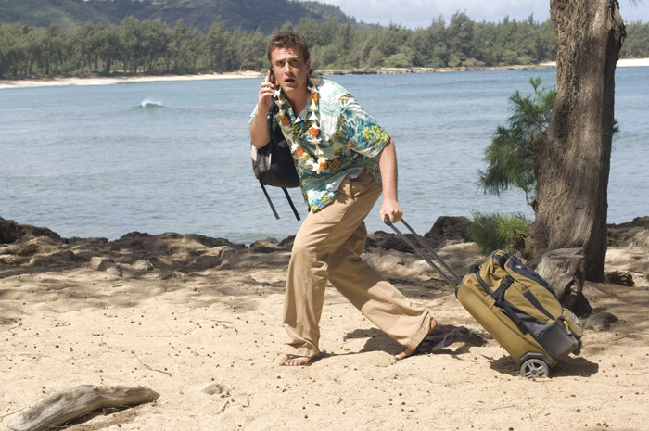
High Key
Bright, even illumination with few shadows
Comedies, Family films, Musicals, etc.

Slide 23
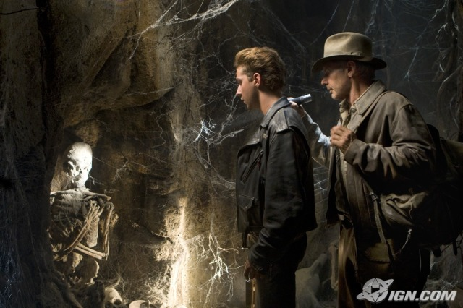
Low Key
Mysteries, Thrillers, Gangster Films
Atmosphere pools of light, produces shadows and darkness around the subject

Slide 24
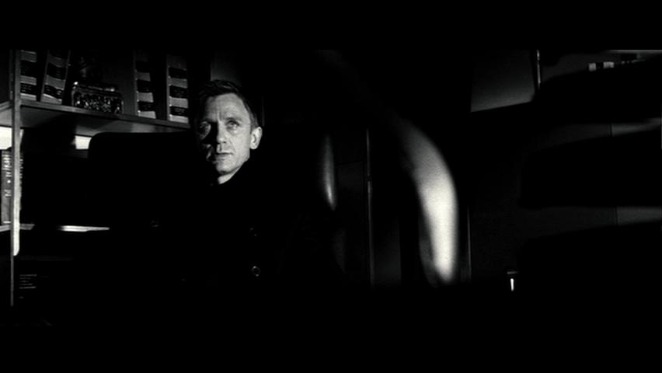
High Contrast
Tragedies and Melodramas
Harsh shafts of light giving dramatic streaks of blackness

Slide 25
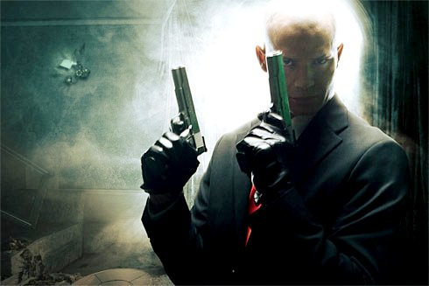
Backlighting
Soft Lighting, Halo effect

Slide 27
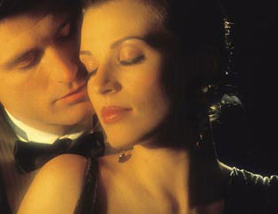
Star Lighting
Designed to flatter the actor, dramatic effect

Slide 28
Camera Movements
MacDonald
Media Literacy

Slide 29
Assignment
In the next few slides, name the shot, angle, or camera movement.

Slide 30
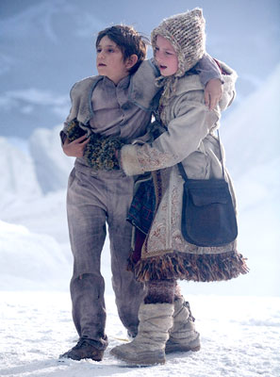
Name the Shot
Medium Long Shot
The Golden Compass, New Line Pictures

Slide 31
Name the Shot
Captain Jack

Slide 32
Name the Shot
Nicole Kidman, The Golden Compass, New Line Pictures

Slide 33
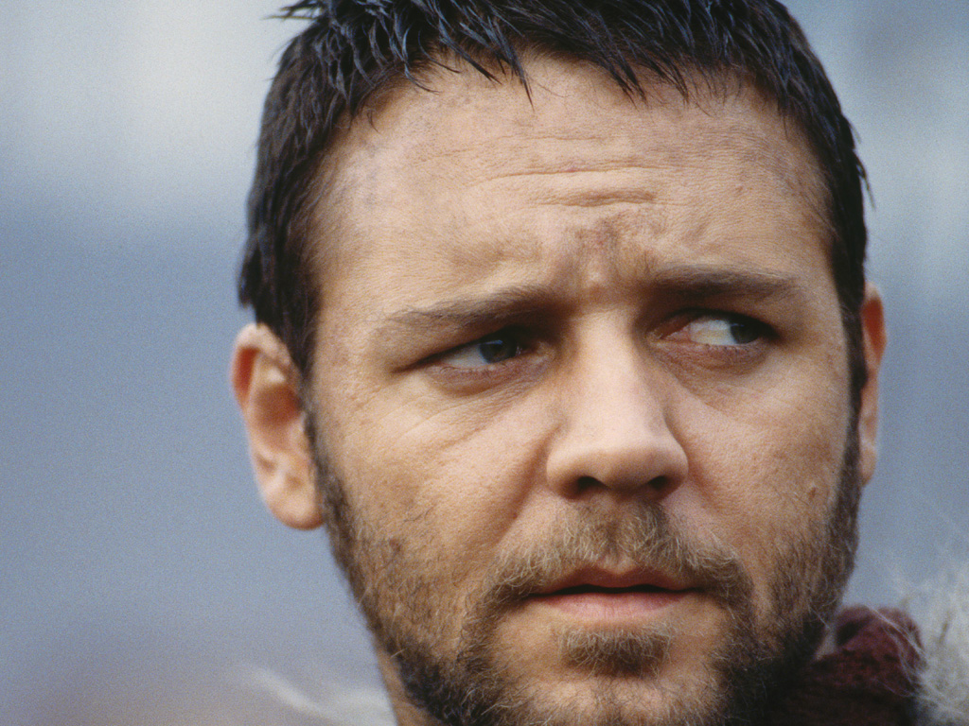
Name the Shot
Russell Crowe as Maximus, Gladiator

Slide 34
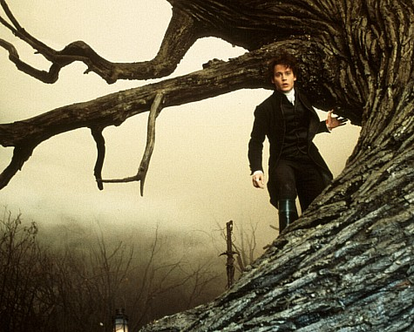
Name the Shot
Johnny Depp, Sleepy Hollow

Slide 35
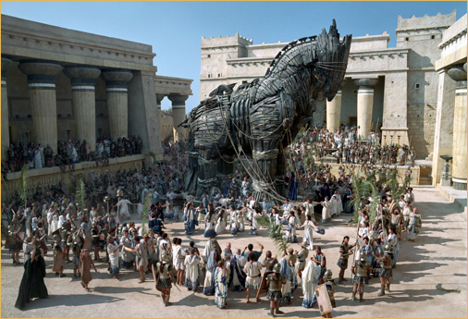
Name the Shot
Troy, Warner Bros. Pictures

Slide 36
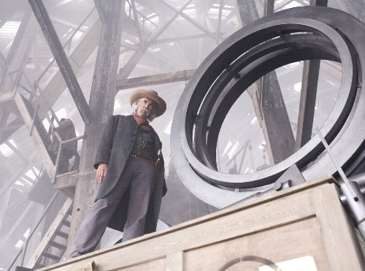
Name the Angle
The Golden Compass

Slide 37
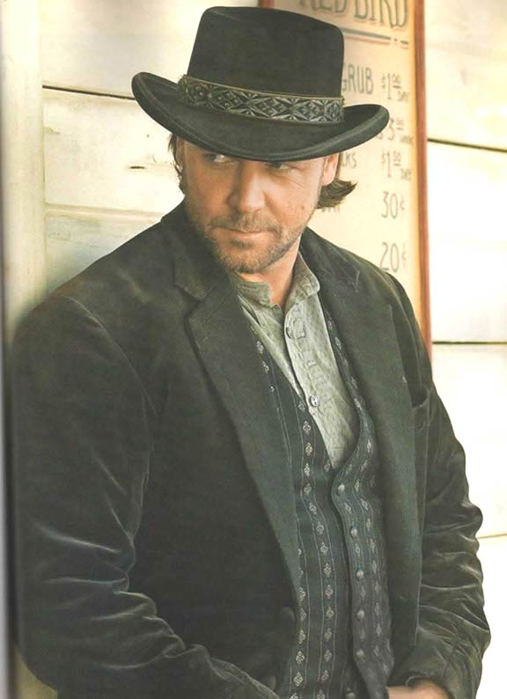
Name the Shot
Russell Crowe,
3:10 to Yuma, Focus Pictures

Slide 38
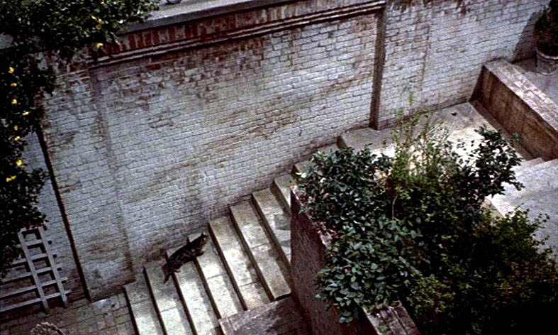
Name the Angle
Rear Window, Alfred Hitchcock

Slide 39
Camera Shot #1

Slide 40
Camera Shot #2

Slide 41
Camera Shot #3

Slide 42
Camera Shot #4

Slide 43
Camera Shot #5

Slide 44
Camera Shot #6

Slide 45
Camera Shot #7

Slide 46
Camera Shot #8

Slide 47
Camera Shot #9

Slide 48
Camera Shot #10

Slide 49
Angle Shot #1

Slide 50
Angle Shot #2

Slide 51
Angle Shot #3

Slide 52
Angle Shot #4

Slide 53
Angle Shot #5

Slide 54
Angle Shot #6

Slide 55
Angle Shot #7

Slide 56
Angle Shot #8

Slide 57
Angle Shot #9

Slide 58
Angle Shot #10

Slide 59
Lighting Shot #1

Slide 60
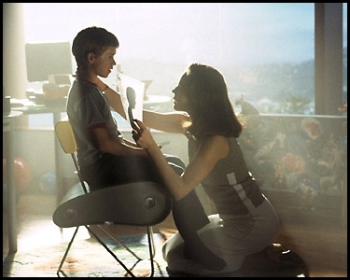
Lighting Shot #2

Slide 61
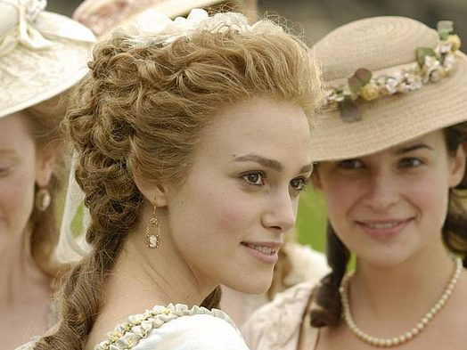
Lighting Shot #3

Slide 62
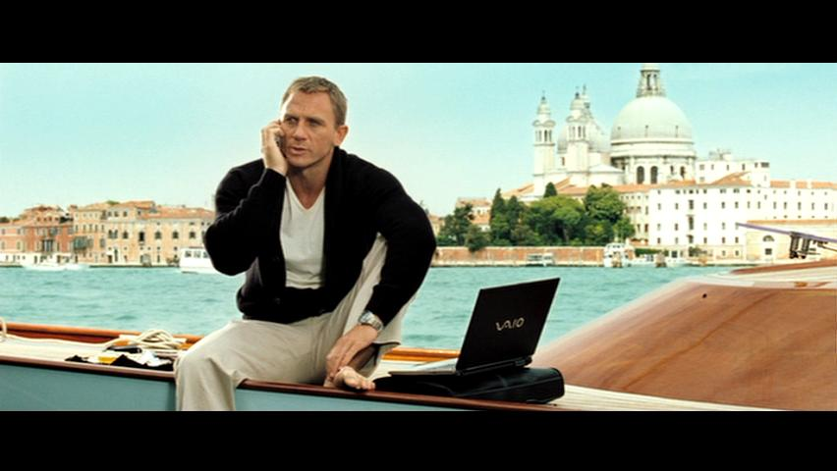
Lighting Shot #4

Slide 63
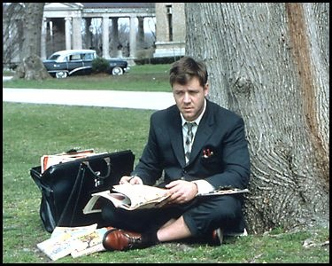
Lighting Shot #5

Slide 64
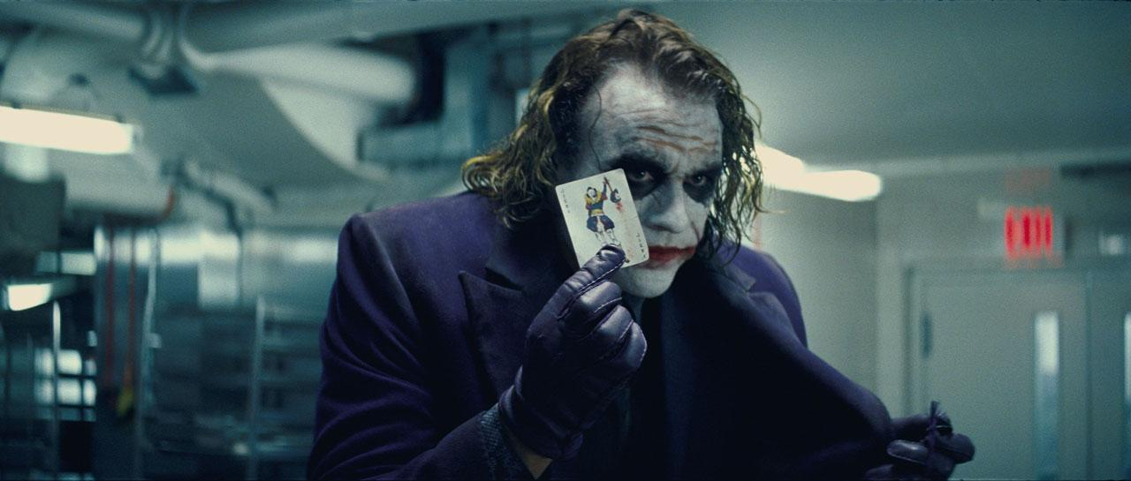
Lighting Shot #6

Slide 65
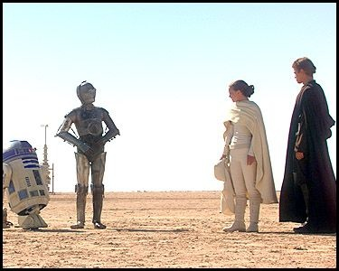
Lighting Shot #7

Slide 66
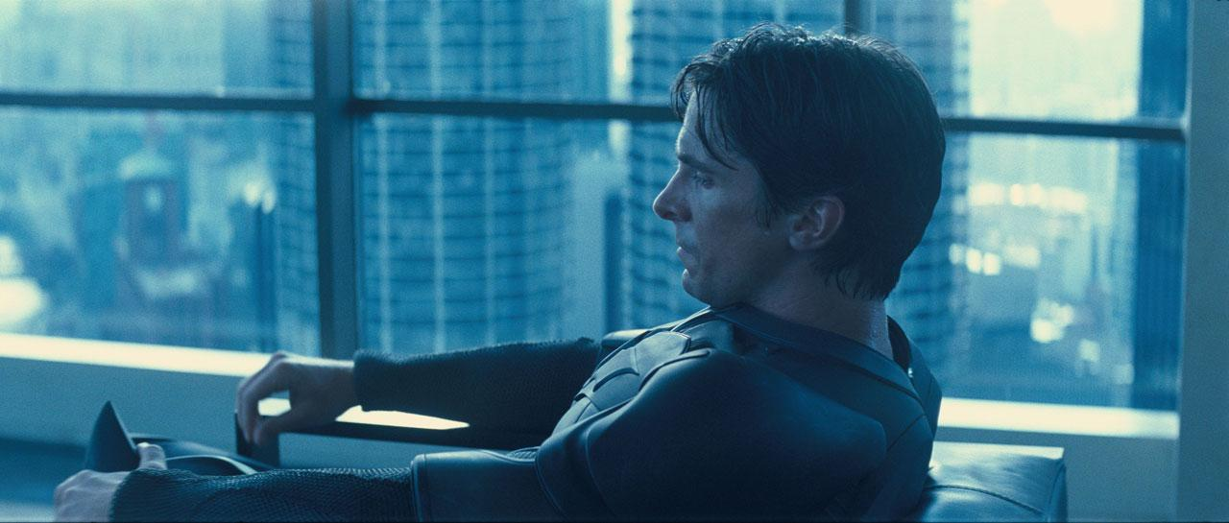
Lighting Shot #8

Slide 67
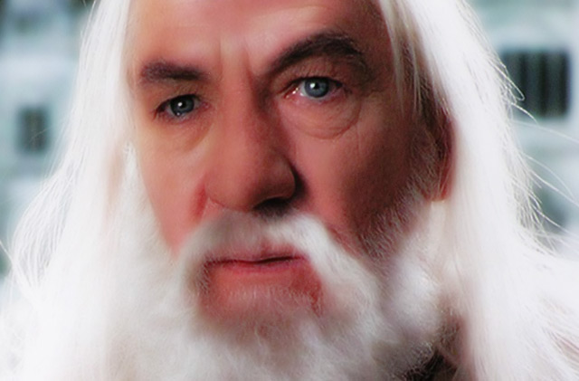
Lighting Shot #9

Slide 68
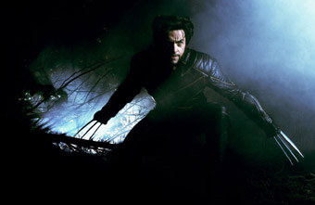
Lighting Shot #10

