Slide 1
Shakespeare Language

Slide 2
Iambic Pentameter de DUB, de DUB, de DUB…
As we have already discussed Iambic Pentameter, this is a quick recap:

Slide 3
Blank Verse
When Iambic Pentameter doesn’t rhyme By what it fed on, and yet within a month – Let me not think on’t! Frailty, thy name is woman! – A little month, or ere those shoes were old

Slide 6
Allusion A statement that his an indirect reference to a work, person, event, etc.
Four Types
Biblical
Literary
Historical
Cultural (pop culture)

Slide 7
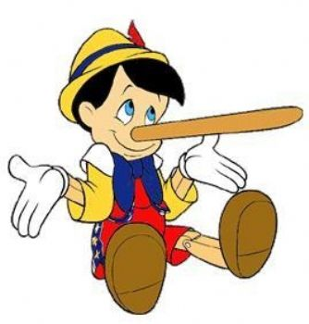
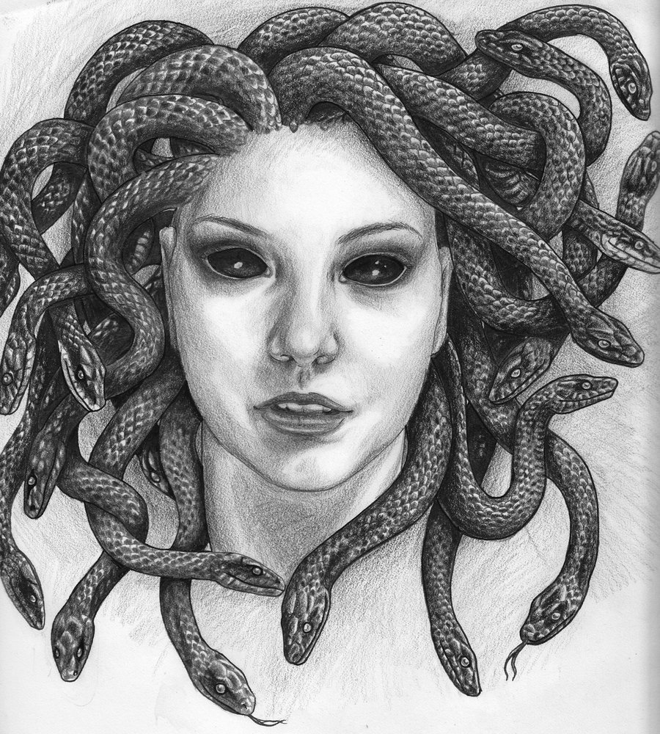
Literary Allusion
A statement that indirectly refers to other well-known literary works
Are you sure you didn't’t eat the last cookie? Your nose is growing.
I went to bed with my hair wet and I woke up looking like Medusa.

Slide 8
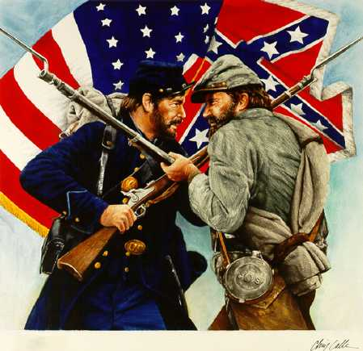
Historical Allusion
A statement that refers to history.
There’s a civil war going on in my family regarding where to go on vacation.
Reference to the American Civil War. . .North versus the south. . . To continue slavery or to abolish it, that was the question…

Slide 9
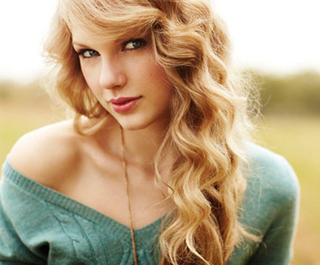
Pop Culture Allusion
A cultural allusion is an association of a person, place, or event within a specific community or culture.
She acts like that because haters gonna hate hate hate hate hate.
Something weird is going on– my spidey sense is tingling.

Slide 10
Effects of Allusions
Helps the reader/viewer understand new information such as characters, setting, plot, etc. by connecting it to something already well-known.
May provide credibility to an argument.
Makes a reader/viewer think and relate the current topic to previous knowledge.

Slide 11
Shakespeare LOVES Allusion
That it should come to this! But two months dead, nay, not so much, not two. So excellent a king, that was to this Hyperion to a satyr, so loving to my mother That he might not beteem the winds of heaven Visit her face too roughly. Heaven and earth,
Hear Minerva speak.” — Lucentio (1.1.84)
Minerva is the Roman equivalent to Athena of Greek mythology. She is the goddess of wisdom.
“Leave that labor to great Hercules.” — Gremio (1.2.255)
Hercules, or Heracles, is a hero of incredible strength from Greek mythology. He was assigned twelve impossible labors by the goddess Hera.

Slide 12
Metaphor and Similes
But soft! What light through yonder window breaks?
It is the east, and Juliet is the sun.
Scaring the ladies like a crowkeeper

Slide 13
Personification
Hath Death lain with thy wife. See, there she lies, Flower as she was, deflowered by him.(40) Death is my son-in-law, Death is my heir; My daughter he hath wedded. I will die

