Slide 1
Multiple Lenses 2
Psychology: Freud and jung

Slide 2
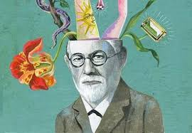
A FREUDIAN ALLEGORY RALPH, JACK, AND PIGGY
Id
The part of the personality reflecting unorganized, instinctual impulses. If unbridled, it seeks immediate gratification of primitive needs.
Ego
The part of the personality corresponding most nearly to the perceived self, the controlling self that holds back the impulsiveness of the id in the effort to delay gratification until it can be found in socially approved ways. The ego tries to balance the id and the superego.
Superego
The part of the personality corresponding most nearly to conscience, superego is said to be the punishing conscience. It is very rigid in its belief of right and wrong.
Unconscious
Memories, impulses and desires that are not available to consciousness, sometimes controlled or repressed.

Slide 3
ID, EGO, SUPEREGO
WHICH ONE ARE YOU?? WHY?
What aspects/character traits do you have for each of the id, ego, and superego?

Slide 4
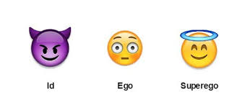
The Three Main Boy as ONE???

Slide 5
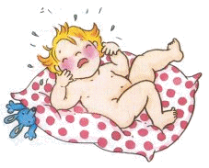
THE ID-WHO?
-the Id is the aspect of our personality that we are born with
-the Id is the part of our personality that is only interested in satisfying our immediate basic needs
-the Id is driven by the desire for pleasure only
In other words, the Id wants whatever feels good at the time, with no consideration for the reality of the situation.
Motivated by pleasure

Slide 6
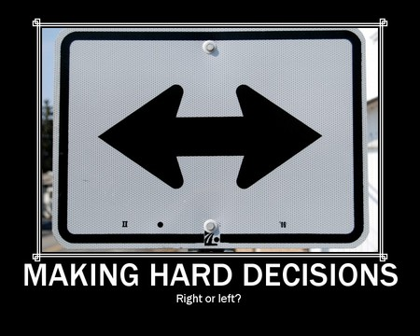
THE EGO-WHO?
The Ego, the second element of personality, begins to develop a few years after the child is born
The Ego is based upon what Freud calls the “reality principle”
-The Ego is aware of reality and must try to meet the demands of the Id while also navigating in the real world that has consequences

Slide 7
THE SUPEREGO-WHO?
By age five we begin to develop our Superego
The Superego is the moral aspect of our personality
Superego develops from the moral and ethical restraints placed on us by our caregivers (ie parents usually)
The Superego is often equated with our conscience as it dictates what is right and wrong

Slide 8
WHAT ASPECT OF OUR PERSONALITY SHOULD BE STRONGEST?
In a healthy person, according to Freud, the ego is the strongest so that it can satisfy the needs of the id, not upset the superego, and still take into consideration the reality of every situation. Not an easy job.
But, if the id gets too strong, impulses and self gratification take over the person's life.
If the superego becomes too strong, the person would be driven by rigid morals and would be judgmental and unbending in his or her interactions with the world.

Slide 9
Carl Jung ---Archetype

Slide 10
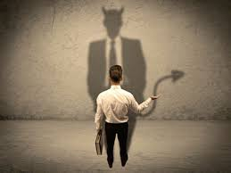
Carl Jungian----Shadow Self
Jungian psychology, the "shadow", "Id", or "shadow aspect/archetype" may refer to (1) an unconscious aspect of the personality which the conscious ego does not identify in itself. In short, the shadow is the "dark side".
We see this idea a lot in media: Batman, Joker, Smeagol---basically, anything that uses a mask and acts outside of their personality “The devil on your shoulder” ---inner voice telling you to act on primitive impulses
Notes:
Wikipedia

Slide 11
Lord of the Flies
Where do we see these concepts in the novel???
Id, ego, superego?
Shadow Self?

Slide 12
Carl Jungian----Shadow Self
Jungian psychology, the "shadow", "Id", or "shadow aspect/archetype" may refer to (1) an unconscious aspect of the personality which the conscious ego does not identify in itself. In short, the shadow is the "dark side".
We see this idea a lot in media: Batman, Joker, Smeagol---basically, anything that uses a mask and acts outside of their personality “The devil on your shoulder” ---inner voice telling you to act on primitive impulses
Notes:
Wikipedia

Slide 13
Lord of the Flies
Where do we see these concepts in the novel???
Id, ego, superego?
Shadow Self?

