Slide 1
Persuasive Writing
Essay

Slide 2
Use Formal Language
DO NOT use
“I” statements
I believe/In my belief…---BAD!!!!!
Only exception is when you are discussing a personal narrative/case study as an example: As a survivor of….
Slang or contractions
U/ Can’t / won’t / I’ll /they’re etc.

Slide 3
Qualifiers/Absolute Language
AVOID
All people / Everyone / You
The author believes
Instead use:
Many people / often / in general
One can assume
This evidence shows/implies

Slide 4
Point of the Essay
To Inform/persuade
Therefore, your essay must have:
One clear point/topic
Support/Evidence that proves your idea

Slide 5
Parts of the Essay
1) Intro Paragraph-:Interest and Inform the reader about your topic
Hook
Background information
Thesis-ARGUMENT
Preview of body paragraphs.
2) Body-3 paragraphs all with one main point that supports your thesis-TIQA
BODY 1 PARAGRAPH
BODY 2 PARAGRAPH
BODY 3 PARAGRAPH
3) Conclusion Paragraph-Wrap it up
Reword main points
Reword thesis
Clincher statement

Slide 6
Intro Paragraph
Format:
Hook
Context
Thesis
Preview of points
Ask yourself: “So What?”
What IS the significance of what you are talking about---even if you don’t believe there is any significance---HUMOR me!

Slide 7
Intro Paragraph
Student A
There are so many reasons not to smoke and the crazy thing is that people do it anyway. Cigarettes contain tar, nicotine, and carbon monoxide. Each of these substances is very harmful.
Annotations:
Some attempt to engage the reader (…the crazy thing…)
Implies a formulaic organizational structure
Weak attempt of a brief overview
No support for the thesis
Thesis present
Score of 2

Slide 8
Compare
Student A
The smooth white surface of a cigarette. As a person lights it they slowly relax. The day is over. How can anyone resist? It’s easy. Especially when a person realizes all of the harm they are causing.
Just think about all those people they are hurting, the innocent people trying to live a normal life. Then a smoker walks by with a cigarette in their mouth. People stare at them in disgust. They try to ignore it, but all the faces are looking, watching, waiting. They sit by the subway entrance in a huge crowd. The smoke slowly drifts into the smoggy air. They hear coughing, sniffling, whispering. Bystanders cover up their noses to get away from the scent.
Annotations:
Grabs reader’s attention.
Implies an organizational structure.
Includes multiple strategies (scenario, taking a stand, contrasting situation).
Adequate choice of support
Thesis/position stated.
Score of 4

Slide 9
Body Paragraph(s)
T.E.E.C.
M.E.A.L.
T.I.Q.U.A.
Make sure every paragraph has ONE idea and it proves your point

Slide 10
One Idea—multiple examples….

Slide 11
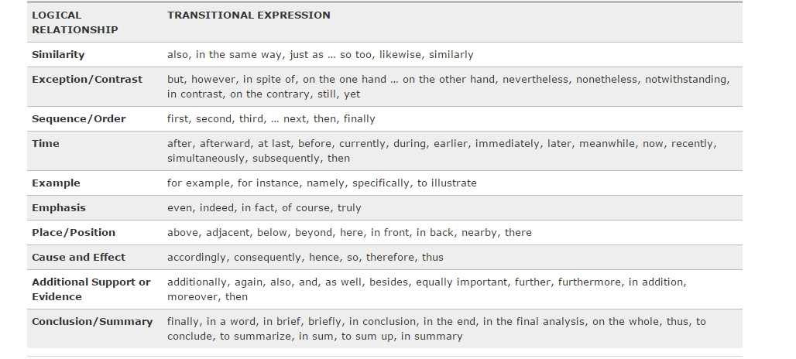
Transitions between Paragraphs

Slide 12
Transitions between IDEAS/Paragraphs
Transitional devices are words or phrases that help carry a thought from one sentence to another, from one idea to another, or from one paragraph to another. And finally, transitional devices link sentences and paragraphs together smoothly so that there are no abrupt jumps or breaks between ideas.

Slide 13
Transitions Continued

Slide 14
Conclusion
Conclusion paragraphs-wrap everything up. They move in the reverse order of the introduction paragraph (specific to general). -Recap points
-Restate thesis -Clincher statement
Make sure it is well developed as this is the impression you are leaving the reader with.
Ask yourself ‘so what?’ to figure out the importance of your topic; refer back to the introduction; synthesize and show your reader how your argument, examples, and ideas fit together; include provocative insight

Slide 15
Plagiarism
You must cite all sources. Anytime you summarize, paraphrase, or directly quote from a source, you must credit the author.
Plagiarism is defined as the passing off of another person’s work as if it were one’s own. An unacknowledged use of words, ideas, information, research, or findings not your own, taken from any source, is plagiarism.
other words, DON’T PLAGIARIZE!
USE MLA CITATION

