Slide 1
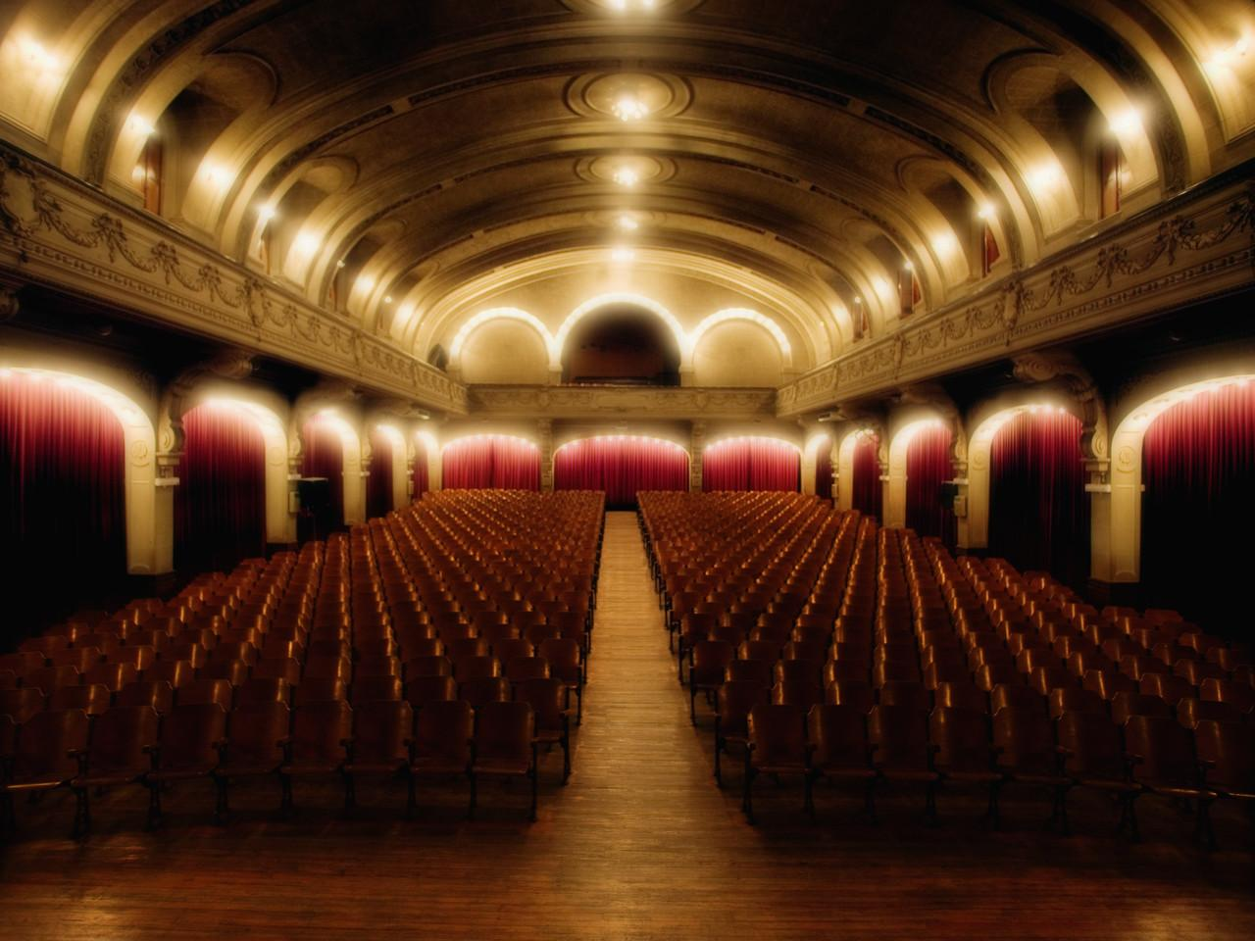
Getting into it: Understanding film techniques

Slide 2
Music
Lighting
Types of shots: what is in the frame? size of the characters?
Shapes and Symbols?

Slide 3
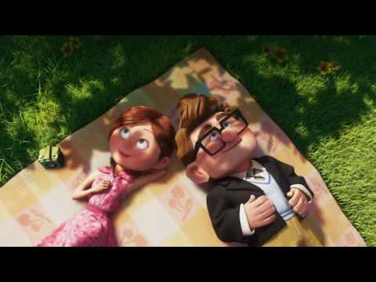

Slide 4
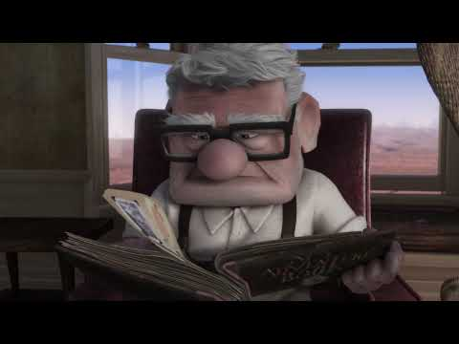

Slide 5
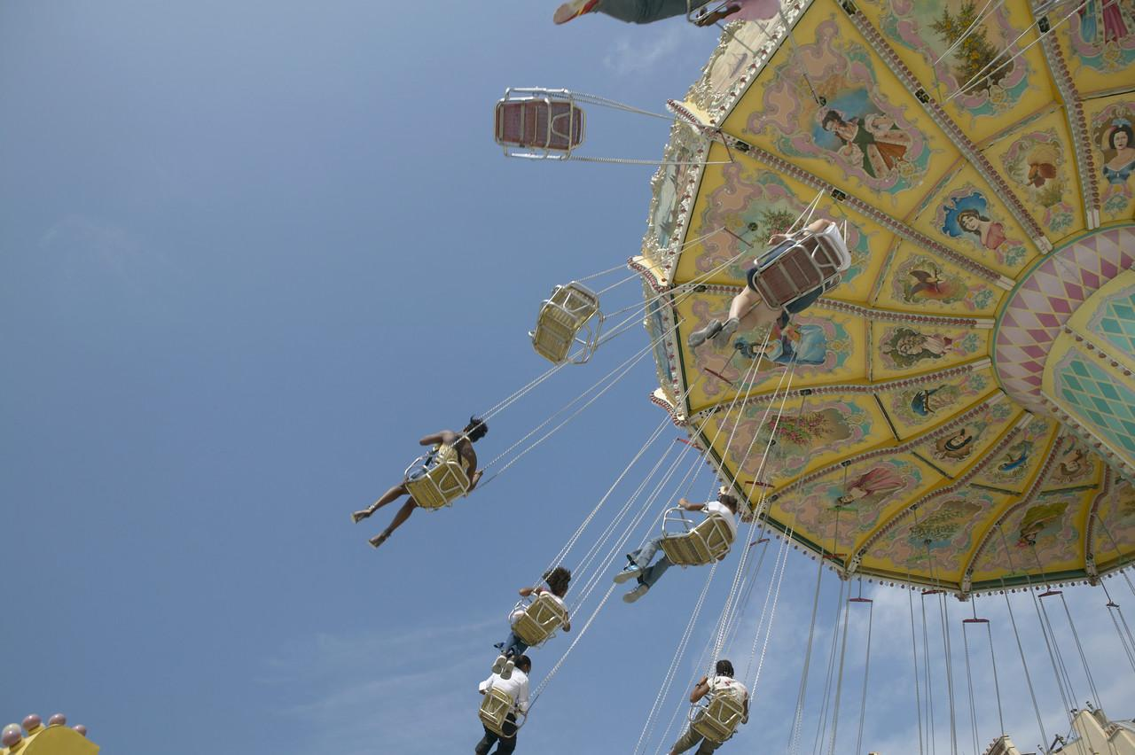
There is more to a film than just watching…
Cinematic techniques are methods employed by film makers to communicate meaning, entertain and to produce a particular emotional or psychological response in an audience.

Slide 6
Cinematography:
Cinematographic techniques such as the choice of shot, and camera movement, can greatly influence the structure and meaning of a film.

Slide 7
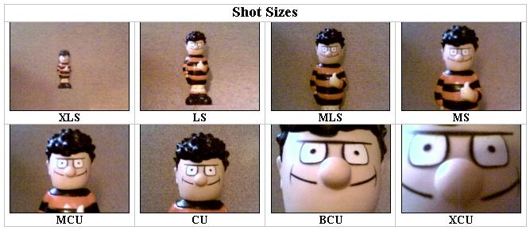
Shot Types and Reasons:
Distance of shot: the use of different shots can influence the meaning which an audience will interpret:
The abbreviations are as follows:
XLS - Extreme Long Shot MCU - Medium Close-up
LS - Long Shot CU - Close-up
MLS - Medium Long Shot BCU - Big Close-up
MS - Medium Shot XCU - Extreme Close-up / Detail

Slide 8
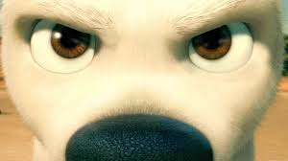
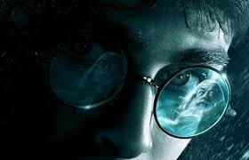
ECU
Extreme close-up: Focuses on a single facial feature, such as lips and eyes.

Slide 9
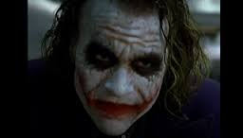
CU
Close Ups: Often used to emphasise emotions or show the characters’ faces during a conversation

Slide 10
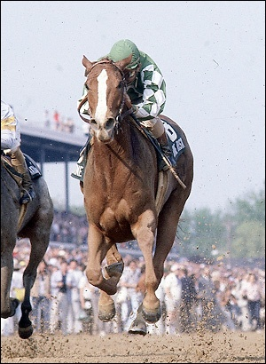
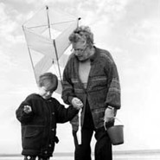
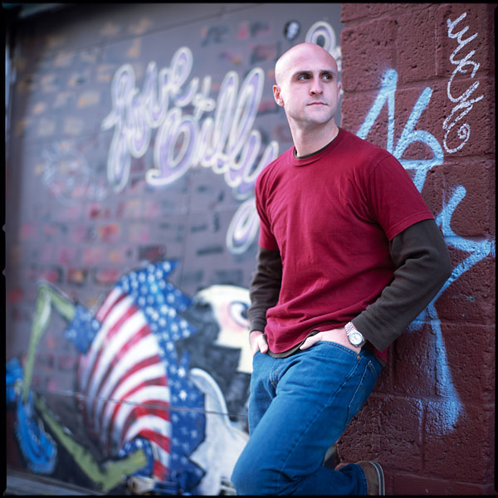
THE OTHER TYPES OF SHOTS:
Medium Close-ups, Medium Long shots, Long shots: Used to create variety when showing action in a setting.

Slide 11
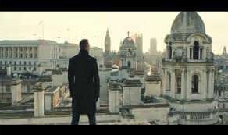
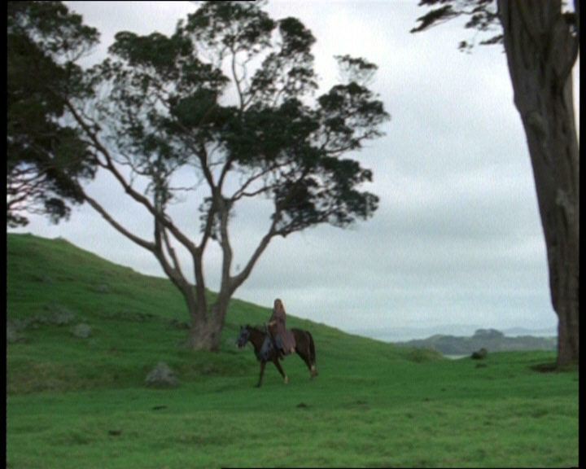
Establishing shot:
Establishing shot: Mainly used at a new location to give the audience a sense of locality.

Slide 12
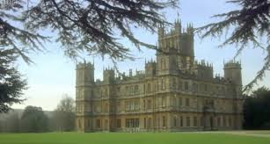
Establishing shot

Slide 13
Camera Movement:
Pan: Generally used to help establish a setting, or to follow action
Tilt: A vertical pan that is often used to show a subject’s superiority or power (by starting at ground level and titling up to the top)
Zoom: The zoom lens allows the camera operator to start with a wide angle (extreme long or long shot) and ‘go in tight’ to a narrow angle (close up or extreme close up) - or vice versa.

Slide 14
Camera Angles:
These are used extensively to communicate meaning and emotion about characters:
Low angle shot: Looking up at a character or object, often to instil fear or awe in the audience;
Straight angle shot: Looking at an eye-level angle to a character or object, giving a sense of equality between subject and audience;
High angle shot: Looking down on a character, often to show vulnerability or weakness;

Slide 15
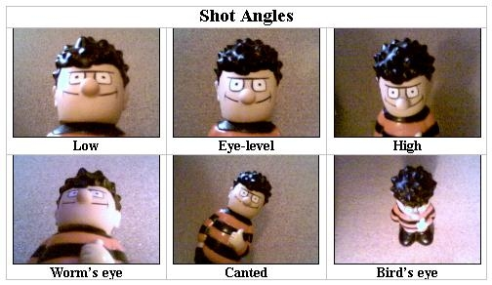
Continued:
Canted or Oblique: The camera is tilted to show the scene at an angle. This is used extensively in the horror and science fiction genre. The audience will often not consciously realize the change. This is most often referred to as a 'dutch' angle, or 'going dutch'.

Slide 16
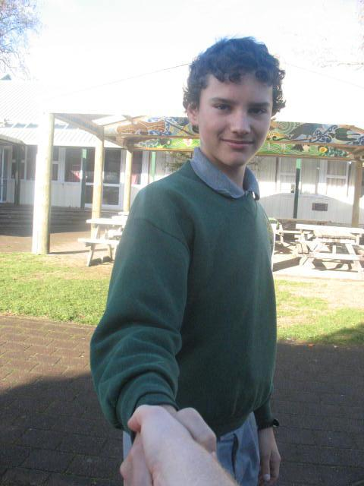
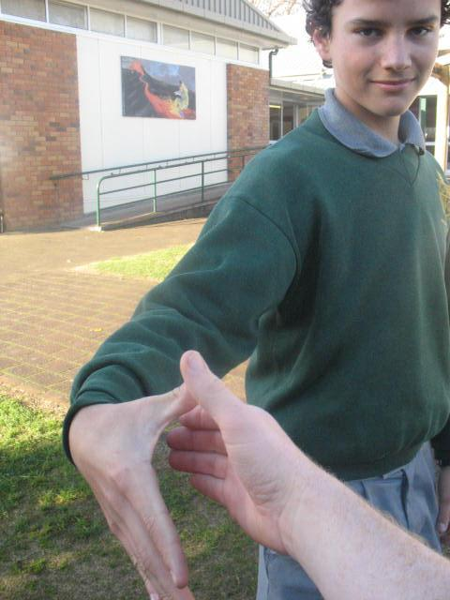
POV (Point of View) shot
The view of a scene or person as a
character sees it

Slide 17
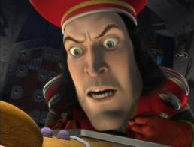
Low angle shot
Makes character / item look dominating, taller.
This shot is often used in films to emphasize authority and power.

Slide 18
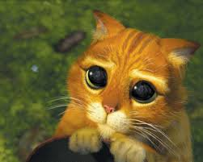
High angle shot
A shot that is looking down upon a subject- shows lesser amounts of
dominance / status

Slide 19
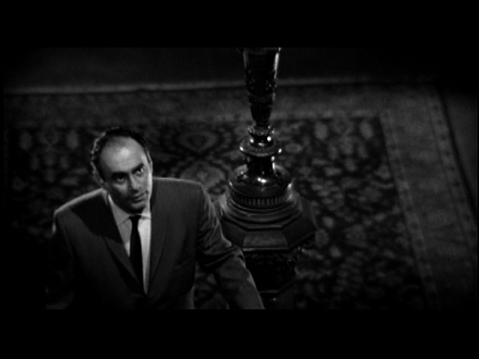
Another high-angle shot
Try to imagine what might be happening in this scene.

Slide 20
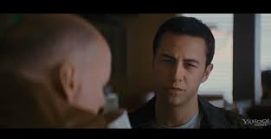
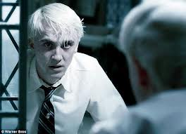
Over the shoulder shot
Often used in dialogue scenes to
highlight faces

Slide 21
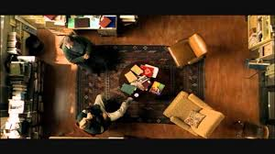
Bird’s eye view angle
he shot is photographed directly from above. This type of shot can be disorienting, and the people photographed seem insignificant.
The shot is photographed directly from above. This type of shot can be disorienting, and the people photographed seem insignificant.

Slide 22
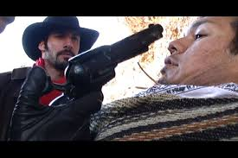
Oblique angle
A shot which is photographed by a tilted camera. When the image is projected on the screen, the subject itself seems to be tilted on its side. This angle creates a sense of anxiety and psychological distress.
he shot is photographed directly from above. This type of shot can be disorienting, and the people photographed seem insignificant.

Slide 23
Sequences
Sequences play an important role in film and television. They help to ensure that the viewer understands the action which is occurring within the film.
A sequence is created when two or more shots are put together to build a ‘narrative’. Sequences are possible due to editing.
Editing allows shots to be physically, electronically or digitally placed one after another on film, videotape or computer software.

Slide 24
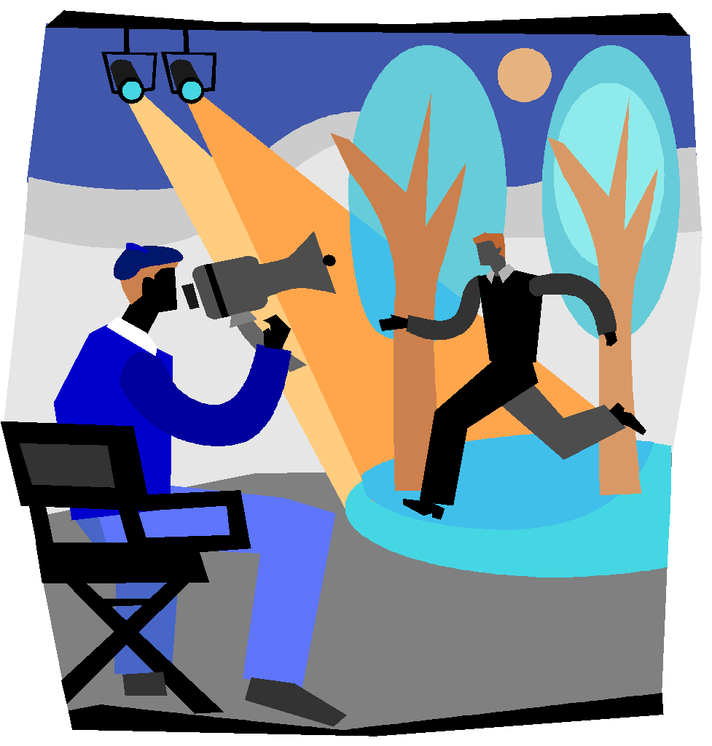
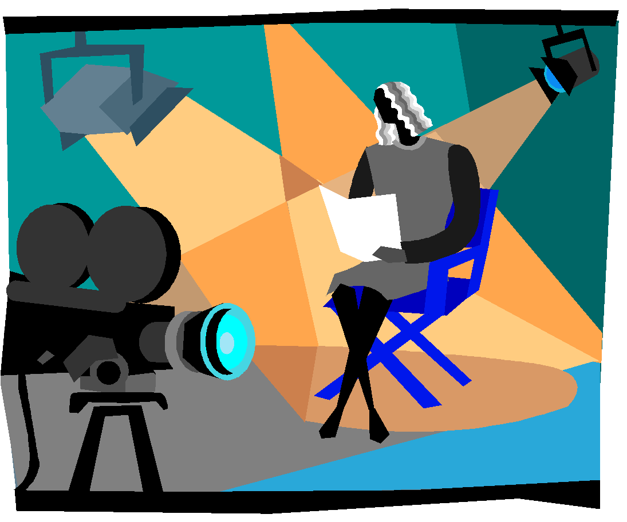
Continuity
The most important factor for a sequence to successfully communicate is continuity. Continuity occurs when two shots match each other in a natural and seamless way (hence match cuts are the most common cuts).

Slide 25
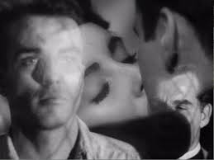
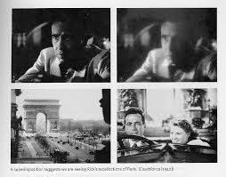
Camera Transitions
Cut
Instant change of shot without using an effect
Gradual dissolve
One image slowly replacing another so that at the midpoint you can see both on the screen.
Wipe
One shot is covered up or replaced by another shot moving horizontally across the screen.

Slide 26
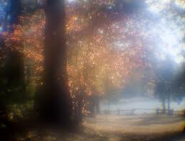
Soft Focus
A slightly blurred shot to make the subject seem more attractive, romantic, nostalgic or dreamlike.

Slide 27
HIGH KEY – the scene is flooded with light; creating a bright and open-looking scene
From the movie “Shawshank Redemption”

Slide 28
LOW KEY – the scene is flooded with shadows and darkness, creating suspense and suspicion
From the movie “Insidious”

Slide 29
Bottom or Side Lighting – direct lighting from below or the side, which often makes the subject appear dangerous or evil
From the movie “The Blair Witch Project”

Slide 30
Front or Back Lighting – soft lighting on the actor’s face or from behind which gives the appearance of innocence or goodness, or a halo effect.
From the movie “The Princess and the Frog”

Slide 31
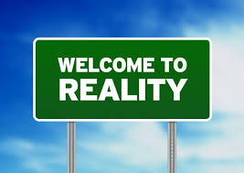
SOUND
Sound whose source is visible on the screen or whose source is implied to be present by the action of the film:
Diegetic Sound Diegetic sound is also known as actual sound
voices of characters
sounds made by objects in the story (musical instruments as they appear in the story.

Slide 32
Non-diegetic sound
Sound whose source is neither visible on the screen nor has been implied to be present in the action:
narrator's commentary
sound effects which is added for the dramatic effect-mood music
Non-diegetic sound is represented as coming from the a source outside story space.

Slide 33
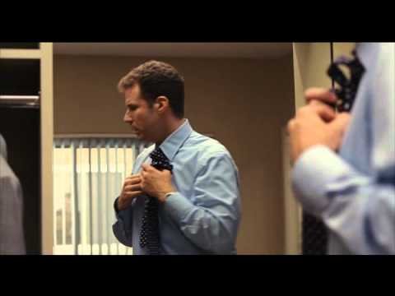
List all of the diegetic and non-diegetic sounds

