Slide 1
Character Types: Round, Flat, Static, Dynamic, Foil, and Stock

Slide 2
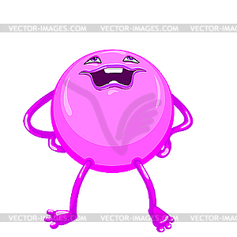
Round:
Round:
A well developed character who demonstrates varied and sometimes contradictory traits. Round characters are usually dynamic (change in some way over the course of a story).
Example:
A character in a story named Elaine never cuts anybody a break. She tells her friends and coworkers that charity and compassion have no place in society. On the other hand, Elaine can never pass up feeding a stray kitten or puppy, and always tries to find a good home for lost or abandoned pets.

Slide 3
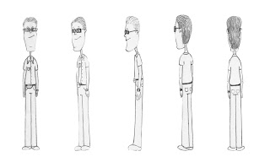
Flat:
Flat
A character who reveals only one, maybe two, personality traits in a story or novel, and the trait(s) do not change.
Example:
In a story about a teacher named Sandra Smith, Louis Dart is a janitor in her building. Louis is always happy and easygoing whenever Sandra runs across him.

Slide 4
Static:
Static Character:
A character that remains primarily the same throughout
a story or novel. Events in the story do not alter a static
character’s outlook, personality, motivation, perception, habits, etc.
Example:
Bert, a bumbling salesman, never takes the time to organize his files, properly record his sales, or follow up with customers. Finally, his boss gets fed up and fires him. Bert struggles for two months to find a new sales position. During that time, his car is repossessed for nonpayment and he maxes out his credit cards. Bert finally finds a new sales position but, before a week passes, he is called into a conference with his new boss. Bert is informed he must get organized or he’ll be fired. A week later the new boss fires Bert after he fails to follow up with an important customer.

Slide 5
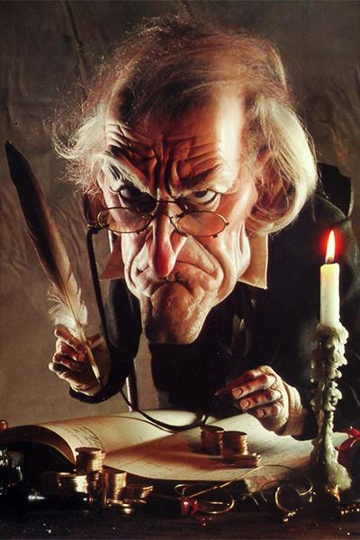
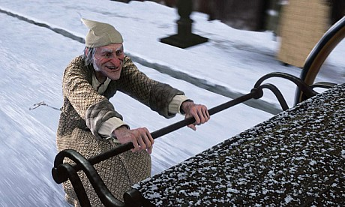
Dynamic:
A character who changes during the course of a story or novel. The change in outlook or character is permanent. Sometimes a dynamic character is called a developing character.
Example:
Ebenezer Scrooge, in A Christmas Carol by Dickens, was very stingy with his money. He worked his employees very hard for little pay. After his experiences with the ghosts that visited him, he changed his ways, paying his employees a more than fair wage, providing days off work and actually giving gifts.

Slide 6
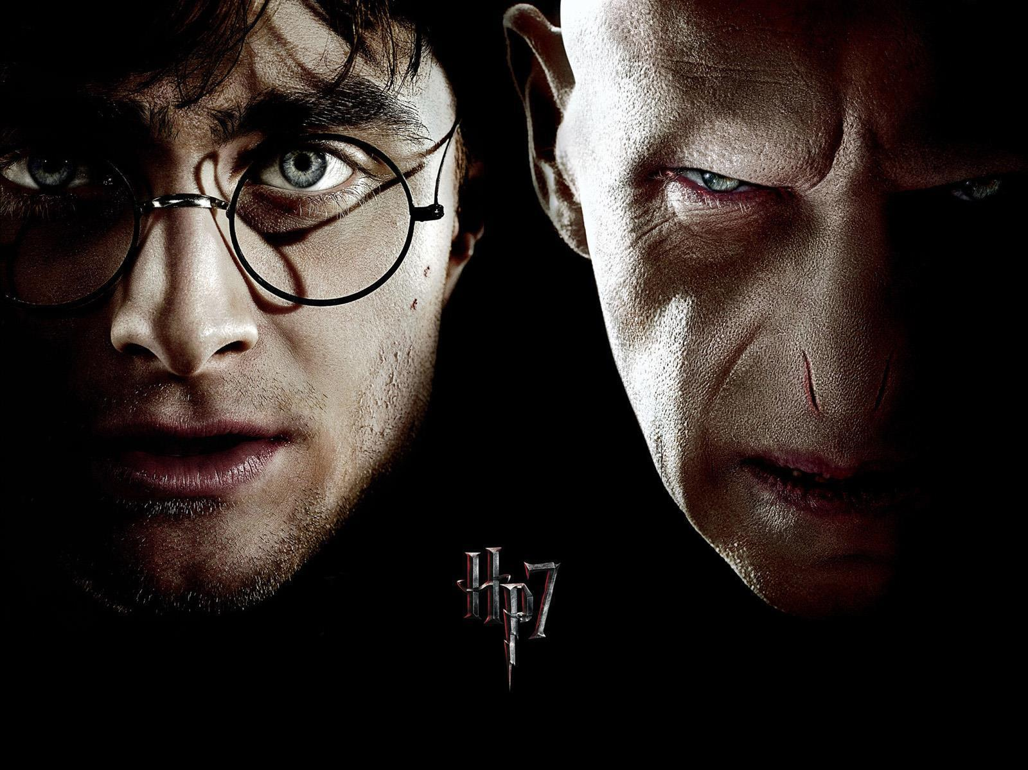
Foil:
A character that is used to enhance
another character through contrast.
Cinderella’s grace and beauty as opposed
to her nasty, self-centered stepsisters is
one clear illustration of a foil.
Example:
The main character in a story, a teenager named Sally, is a very honest person. She always tries to tell the truth and consider everyone’s feelings. The teacher assigns Betty to be Sally’s science lab partner. Betty enjoys gossip and likes to see people’s reactions, especially if it involves hurt or embarrassment. In this example Betty is a foil.

Slide 7
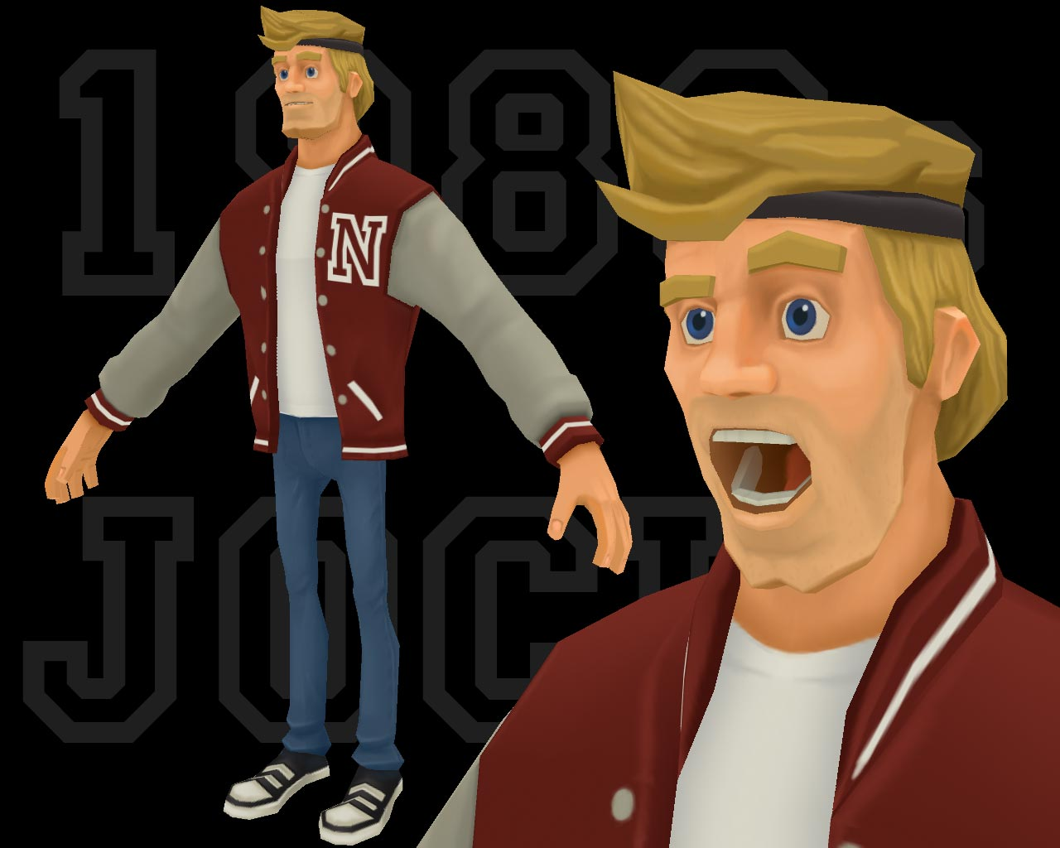
Stock:
A character that is based upon a stereotype.
Example:
Dave is a jock who is good looking, popular, funny and dates the head cheerleader at his school.

